Slide 1
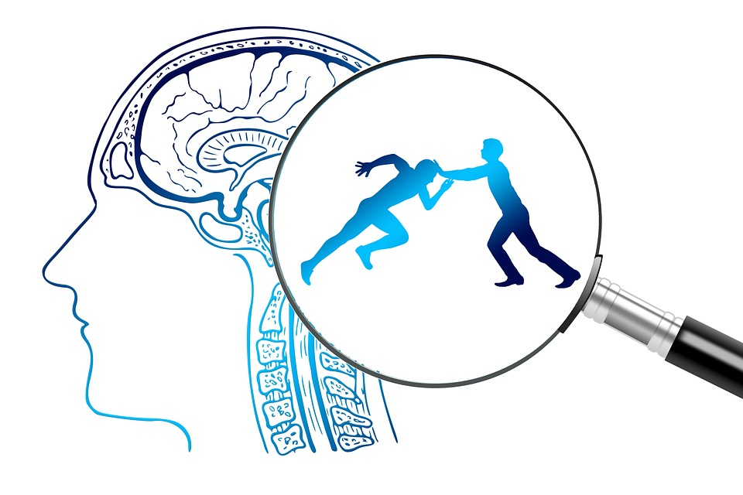

UNIT 1 & 2 − Sport Psychology 3rd ed.
https://pixabay.com/illustrations/brain-think-thoughts-psychology-4065092/

Slide 2
UNIT 1 & 2 − Sport Psychology 3rd ed.
COPYRIGHT
© PE Studies Resources 2019.
All rights reserved.
No part of this publication may be reproduced, stored in a retrieval system or transmitted in any form by any means whatsoever without the prior permission of PE Studies Resources.
DISCLAIMER
This product has been developed to assist teachers in the delivery of the Unit 1 & 2 WACE Physical Education Studies course. It represents the authors’ interpretation and approach and is not endorsed by any governing body. Every effort has been made to ensure the accuracy of the information in this PowerPoint. PE Studies Resources cannot take responsibility for any claim, loss, damage or liability arising from the use of, or reliance on, the information contained in this resource.

Slide 3
CONTENTS
Introduction to sport psychology
Mental skills Motivation Intrinsic vs extrinsic Strategies to improve motivation Influence of age, skill level and activity type Self confidence Self efficacy Strategies to improve self confidence Stress management Stress process Strategies to improve stress management Concentration Nideffer’s Model of Attention Strategies to improve concentration Influence of age, skill level and activity type Arousal Inverted U Hypothesis Strategies to reduce arousal Strategies to increase arousal Influence of age, skill level and activity type

Slide 4
CONTENTS
Mental skills strategies Self talk Self talk and stress Self talk and motivation Self talk and concentration Self talk and arousal Imagery Imagery and stress Imagery and motivation Imagery and concentration Imagery and arousal Relaxation Relaxation and stress Relaxation and motivation Relaxation and concentration Relaxation and arousal
Goal setting Types of goals Effective goal setting Influence of age, skill level and activity type
References

Slide 5
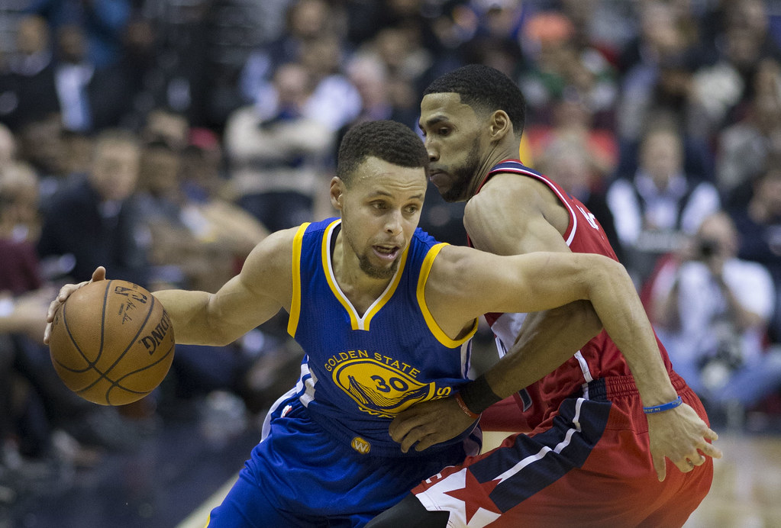

INTRODUCTION TO SPORT PSYCHOLOGY
Sport Psychology can be defined as the study of how the human mind influences sports, athletic performance, exercise and physical activity.
Specifically, it investigates how an individuals thoughts, feelings and emotions influence their performance in physical activity.
Coaches who incorporate psychological skills training into their programs are likely to produce athletes with the most consistent and outstanding results.
https://www.flickr.com/photos/keithallison/24689492152
Home

Slide 6
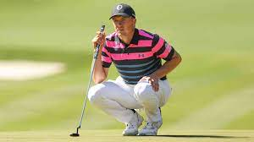
INTRODUCTION TO SPORT PSYCHOLOGY
How important are mental skills in sport?
Why is it that some days you can produce almost perfect sporting performances and other days you perform poorly?
Your physical state hasn’t changed, so the difference must be something else...
…..the difference must be the result of variations in your mental skills
It has been said that mental and psychological factors account for at least 50% of the process of performing well
Jordan Spieth's Epic Meltdown at the Masters - YouTube
https://www.flickr.com/photos/keithallison/24689492152
Home

Slide 7
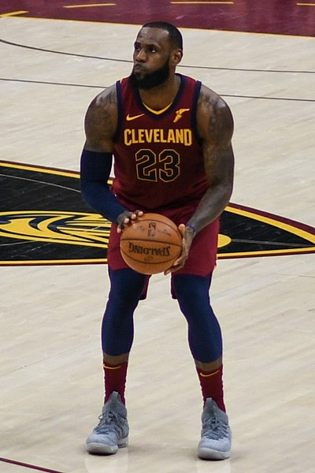
INTRODUCTION TO SPORT PSYCHOLOGY
Psychological Skills Training (PST) (also known as mental skills training)
Is the regular practice of mental skills with the goal being able to improve physical skills.
Strong mental skills are crucial in developing “mental toughness” in the performer.
Mental toughness is crucial to sporting success. A mentally tough athlete;
Has the ability to focus and concentrate
Is able to rebound from failure (resilience)
Is able to deal with pressure
Persists against adversity
https://commons.wikimedia.org/wiki/File:LeBron_James_with_Cleveland_2018.jpeg
Home

Slide 8
INTRODUCTION TO SPORT PSYCHOLOGY
Psychological Skills Training
Developing psychological skills is a 3 step process;
1. Education Phase
Players are made aware of what psychological skills are and how they could benefit and improve their performances by using them.
2. Acquisition Phase
Players determine what specific psychological skills would benefit them and when, why and how they would use them.
Different players have different needs;
Fred gets so nervous before a game that his performance suffers
Emma who makes many unforced errors during a game
Emma and Fred would use different methods to improve their performances.
3. Practice Phase
The necessary mental skills are regularly practiced until the player can use them without conscious thought in a game. Application of mental skills becomes an automated response when needed.
Home

Slide 9
INTRODUCTION TO SPORT PSYCHOLOGY
Mental skills
Motivation
Stress Management
Concentration
Arousal regulation
Self- Confidence
The mental skills required for improving performance and achieving the ideal performance state (‘the zone’) are as follows:
Motivation
Self-Confidence
Arousal
Concentration
Stress management
Home

Slide 10
INTRODUCTION TO SPORT PSYCHOLOGY
Mental skills strategies
Relaxation
Self talk
Imagery
These skills are developed using a range of strategies and are discussed later in this PowerPoint:
Self talk
Imagery
Relaxation
Note*
There are many other strategies used to regulate mental skills however the syllabus document only refers to these 3.
Home

Slide 11
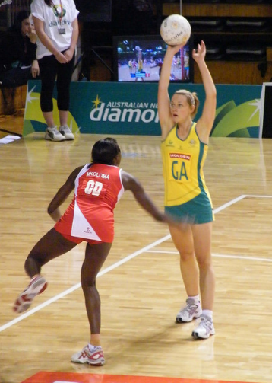
INTRODUCTION TO SPORT PSYCHOLOGY
Mental skills ⎯ definitions
Stress management
Stress occurs when there is an imbalance between the demands of the task and the ability level of the performer to respond in a situation where failure has consequences.
Concentration
The ability to focus on a task at hand whilst ignoring irrelevant cues or distractions.
Arousal
The degree of stimulation or alertness present in a performer about to perform a skilled task.
Motivation
The direction and intensity of effort by a performer towards a given task.
Self-confidence
The belief that a performer has in their own ability to successfully perform a desired skill or behaviour.
https://www.flickr.com/photos/naparazzi/2927067231
Home

Slide 12
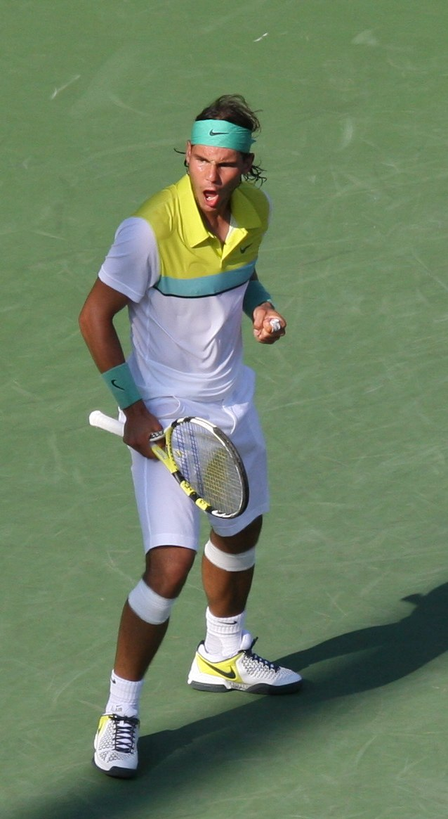
INTRODUCTION TO SPORT PSYCHOLOGY
Mental strategies ⎯ definitions
Relaxation
An activity undertaken to reduce tension and the effects of physical and mental stress
Imagery
The mental recreation, using as many senses as possible, of a successful past performance or skill.
Self-talk
Talking to / thinking to yourself positively before, during or after performance.
Home
https://sco.m.wikipedia.org/wiki/File:Nadal_Miami_2009_1.jpg

Slide 13
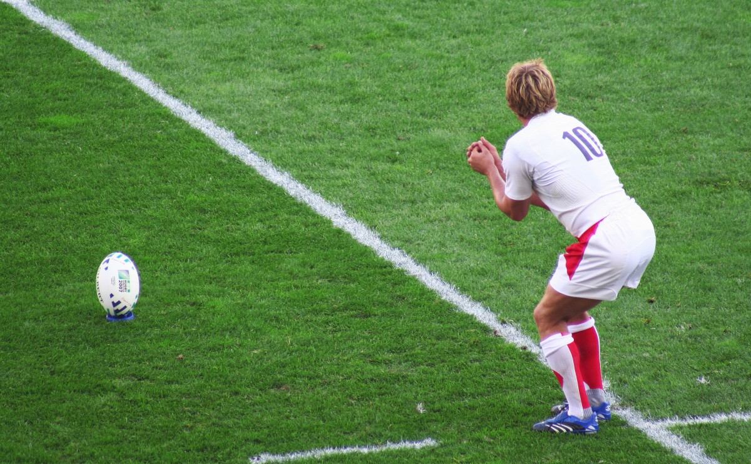
INTRODUCTION TO SPORT PSYCHOLOGY
What are mental skills?
What strategies can be used to develop mental skills?
Motivation
Self-confidence
Stress Management
Concentration
Arousal Regulation
Imagery
Relaxation
Self-talk
The kicker has a kick after the siren to win the game. What mental skills strategies would be important to this player? Why?
Home

Slide 14
MENTAL SKILLS – MOTIVATION
Mental skills required for improving performance and achieving the ideal performance state (‘the zone’)
intrinsic motivation
self-confidence
stress management
concentration or attentional control – Nideffer’s model
arousal regulation for optimal performance including the inverted U hypothesis
influence of age, skill level, and type of activity on mental skills in relation to
motivation
arousal regulation (inverted U hypothesis)
concentration
School Curriculum and Standards Authority. Physical Education Studies ATAR Year 11 Syllabus, 2016.
Home

Slide 15
MENTAL SKILLS – MOTIVATION
Motivation is the direction and intensity of effort and relates to the;
There are 2 types of motivation
Extrinsic motivation
Extrinsic motivation refers to external motivations that result from participation in sport eg: money, winning, fame and awards.
Extrinsic factors can be valuable to get through periods of low motivation e.g. a player coming out of contract may perform at his peak each week even if the team is losing as it increases his chance of getting a new contract or increase his value in the trade market.
Intrinsic motivation
Intrinsic motivation in sport refers to internal motivations that result from the process of participation in sport.
Intrinsic motivation would include;
Playing for enjoyment
Social affiliation
Self-challenge
Thrill seeking e.g. big wave surfing
Home

Slide 16
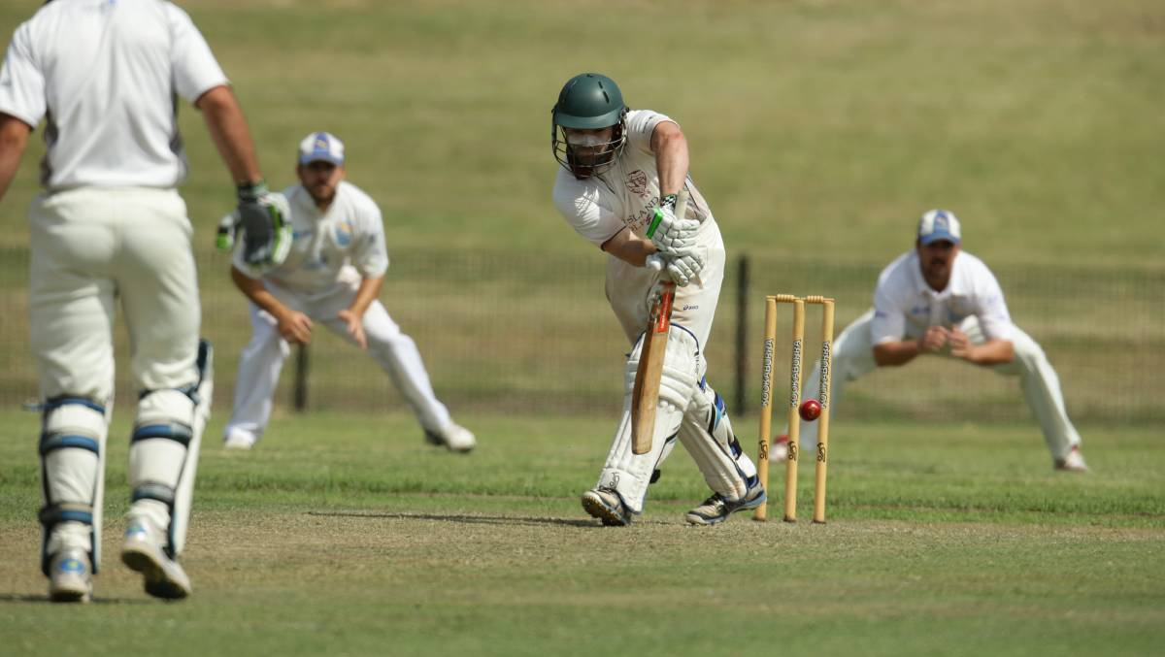
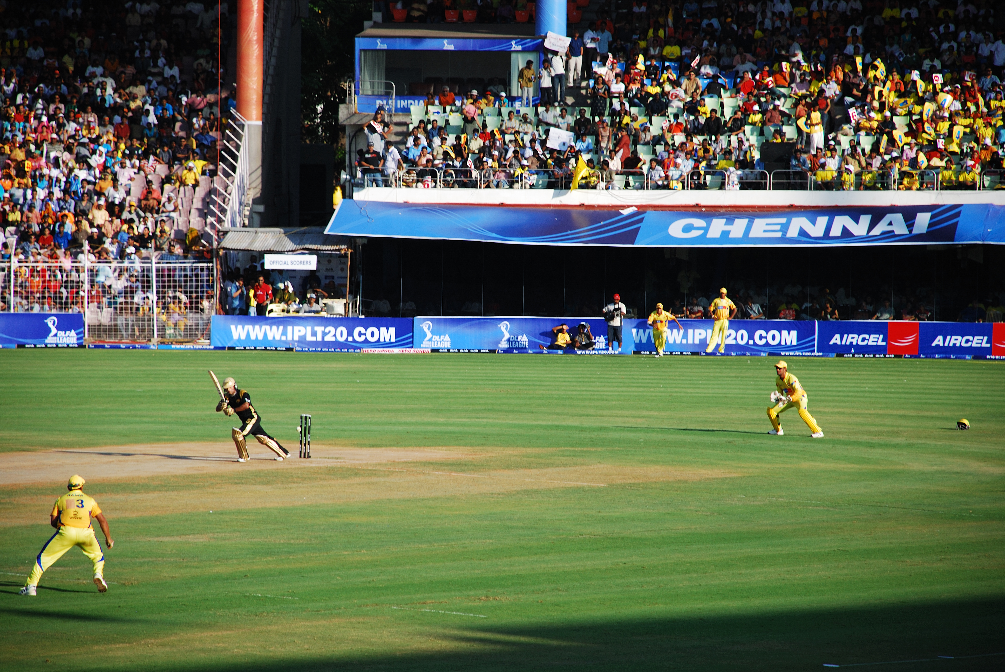
MENTAL SKILLS – MOTIVATION
Intrinsic Motivation
No prize money, no fame, no recognition.
Play for fun, be with mates, fitness, self challenge.
https://www.theherald.com.au/story/4245091/last-stand-sinks-maitland/
Maitland vs. Tamworth - NSW Country Cup
Extrinsic Motivation
Play for prize money, get paid to play, get recognised, chance to play for country.
Majority of elite players, apart from playing for extrinsic reasons, also play for intrinsic reasons e.g. want to compete against the best in the world, be the best in the world.
https://en.wikipedia.org/wiki/Chennai_Super_Kings
Indian Premier League
Home

Slide 17
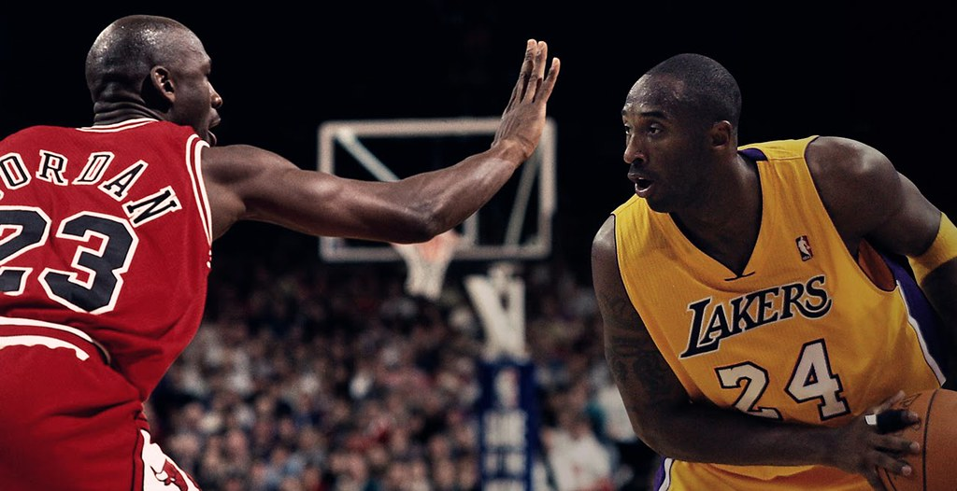
MENTAL SKILLS – MOTIVATION
Which type of motivation is better?
Elite players play for both intrinsic and extrinsic reasons – financial rewards but also self-challenge.
Many elite players retire when the “game stops being fun” and the motivation to train hard and to make the necessary sacrifices is no longer there.
Internal motivation can also keep players involved in the game without the same degree of extrinsic rewards that they received when they were at their peak.
Intrinsic motivation is more powerful than extrinsic motivation.
https://www.flickr.com/photos/zennie62/16008070542
Home

Slide 18
MENTAL SKILLS – MOTIVATION
Strategies to improve motivation and reach the ‘Zone’
Why are players involved
a need to win?
to be with friends?
to keep fit?
What is the situation ⎯ the situation the performer is in can affect motivation e.g. playing a final compared to a pre-season intra-club game.
A player who has performed well in a game and with a high work rate should be positively re-enforced regardless of the outcome. Teams that only value winning lose motivation when they are losing. Recognise performance outcomes.
Make all team members feel they have a key role to play in each game and training needs to be fun and enjoyable.
Consider participant and situational factors
Coaches should teach players appropriate view of success
Make players feel valued
Home

Slide 19
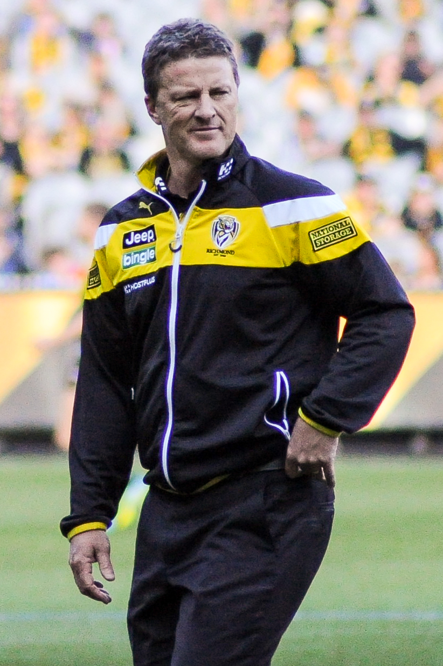
MENTAL SKILLS – MOTIVATION
Leaders / coaches influence team motivation through their body language, facial expression, language and feedback.
A coach looking disinterested on the sideline will negatively affect the motivation of their players on the field.
A passionate and enthusiastic coach positively affects the team.
Set both short and long term goals for individuals and the team as a whole.
Striving for goals promotes motivation.
Goal setting can be implemented using the SMARTER method.
Team leaders need to be enthusiastic
Set team and individual goals for the team
https://en.wikipedia.org/wiki/Richmond_Football_Club
Home

Slide 20
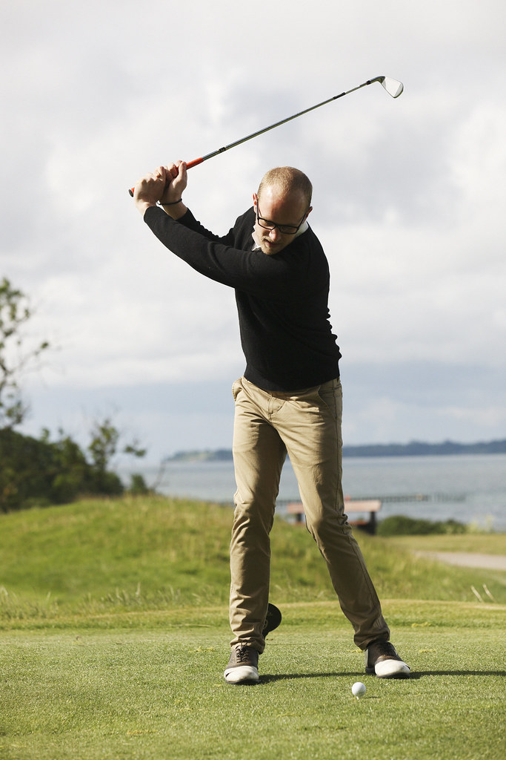
MENTAL SKILLS – MOTIVATION
Influence of age
An individuals age has little impact on their levels of extrinsic and intrinsic motivation
Many kids love playing sport just to be with their friends or because they love the game and are heavily intrinsically motivated
Other kids play sport as they are incentivised by their parents or by the thought of extrinsic rewards
Adults are just as likely to exhibit these traits with many playing due to a long associated love of the game
Other adults play as they are attracted to the fame and recognition that comes with playing the sport
https://www.flickr.com/photos/familjenhelsingborg/16789770789
Home

Slide 21
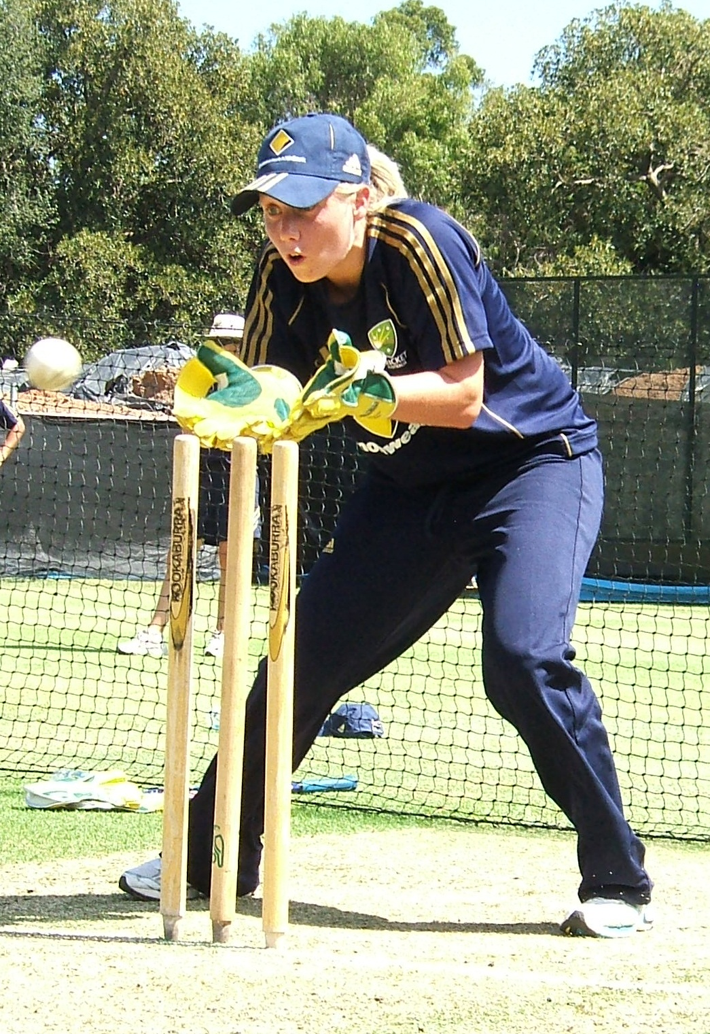
MENTAL SKILLS – MOTIVATION
Influence of skill level
Whilst there is no clear correlation between the skill level of an individual and their motivation, research suggests that individuals engaging in amateur sport are more likely to be intrinsically motivated than professional athletes
It must be recognised however that for these athletes to become professional, it is highly likely that they were intrinsically motivated for the majority of their career as this is usually what drives them to train harder than the rest!
https://en.wikipedia.org/wiki/Alyssa_Healy
Home

Slide 22
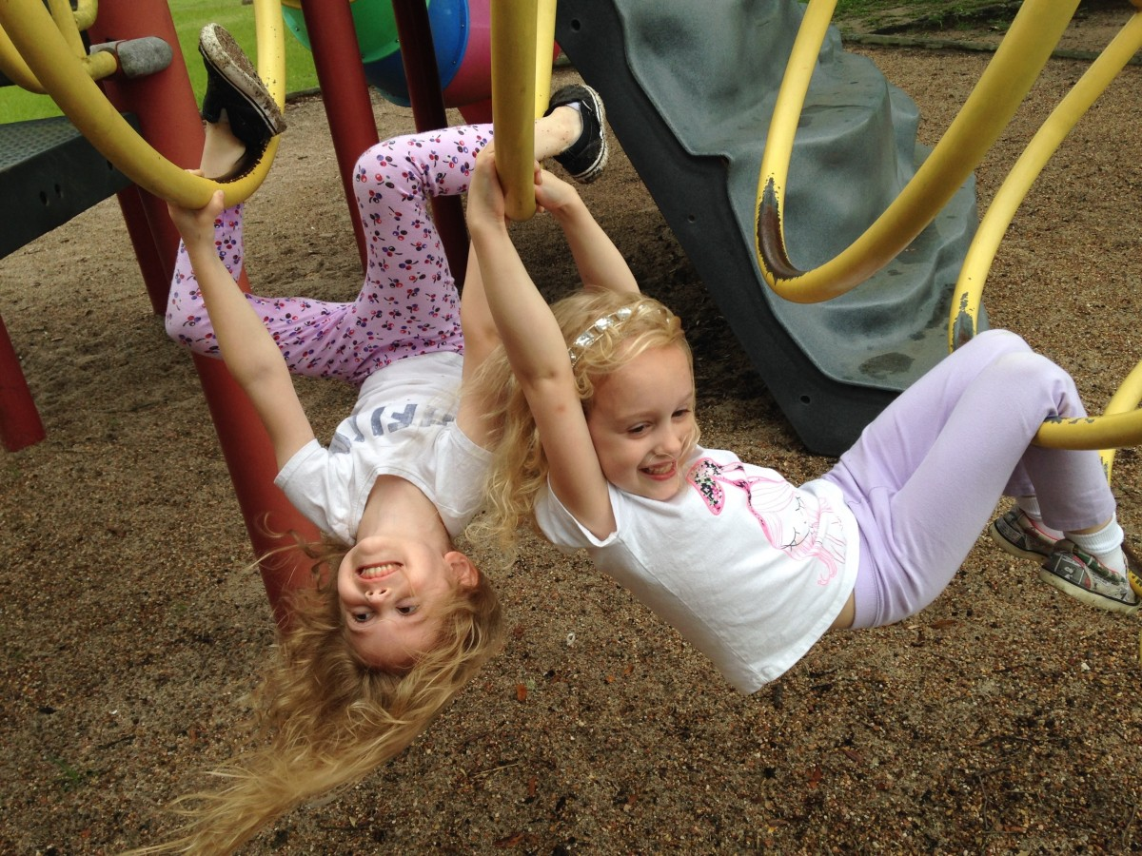
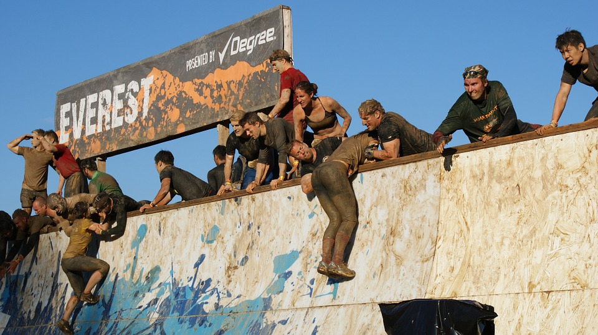
MENTAL SKILLS – MOTIVATION
Influence of activity type
The level of motivation towards a given task is relative to the individual performer
If the activity has the following traits, it’s likely to be intrinsically motivating to the individual
Challenging
Novelty factor
Enjoyable
What is perceived as enjoyable and challenging to one individual is not necessarily enjoyable and challenging to another. These perceptions are typically shaped by a range of environmental and personal factors
Home
https://pxhere.com/en/photo/801535
https://pixabay.com/photos/tough-mudder-teamwork-tough-mud-779285/

Slide 23
MENTAL SKILLS – SELF-CONFIDENCE
Mental skills required for improving performance and achieving the ideal performance state (‘the zone’)
intrinsic motivation
self-confidence
stress management
concentration or attentional control – Nideffer’s model
arousal regulation for optimal performance including the inverted U hypothesis
School Curriculum and Standards Authority. Physical Education Studies ATAR Year 11 Syllabus, 2016.
Home

Slide 24
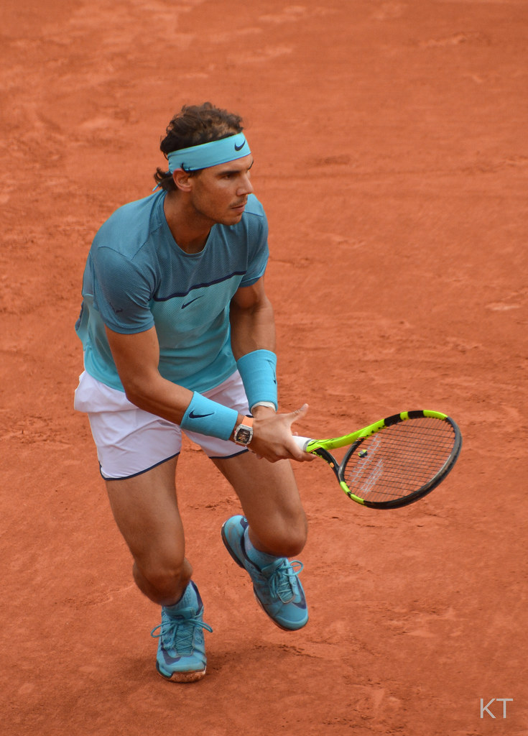
MENTAL SKILLS – SELF-CONFIDENCE
Self-confidence is an individual’s belief that they will execute a given task successfully.
An athletes confidence is influenced by two main factors
Self efficacy
Self belief
Confident players believe in themselves & their abilities (both physical & mental) to reach their potential.
https://www.flickr.com/photos/43555660@N00/27389157522
Home

Slide 25
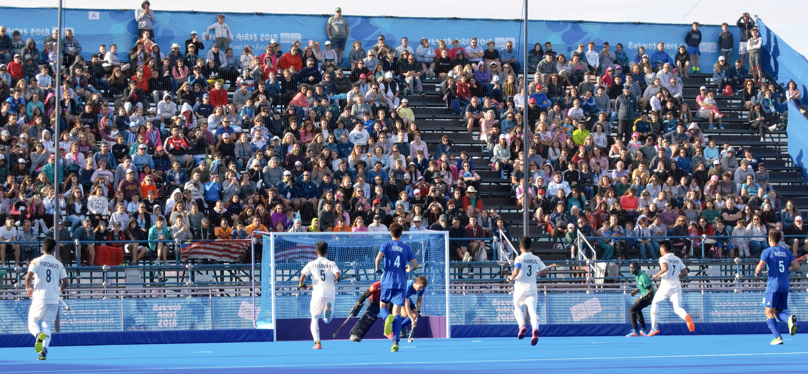
MENTAL SKILLS – SELF-CONFIDENCE
Self-Efficacy
Some sportsmen / sportswomen perform better under certain conditions and are more confident when performing under these preferred circumstances.
The change in an individual’s self-confidence as a result of a given situation is referred to as self-efficacy.
A hockey player may feel more confident playing on synthetic surfaces than on grass. He has high self-efficacy on synthetic pitches and lower self-efficacy when playing on grass.
A netballer may be much more confident playing goal shooter as opposed to goal defence. High self-efficacy as a shooter, low self-efficacy as a defender.
https://commons.wikimedia.org/wiki/File:Field_hockey_at_the_2018_Summer_Youth_Olympics_%E2%80%93_Boys_Preliminary_Round_%E2%80%93_MAS-ARG_(129).jpg
Home

Slide 26
MENTAL SKILLS – SELF-CONFIDENCE
Self confidence and performance
There is generally a close
association with confidence
& your level of performance;
if you are in the optimum
zone for confidence, your
performance is likely to be optimal.
Lacking confidence can result
in poor performance levels.
Low levels of performance can also be
associated with being overconfident.
Optimal level
of confidence
Level of
Performance
Level of
Confidence
As a player’s confidence increases, so does their performance BUT if confidence levels are too high, there is a drop in performance levels.
Home

Slide 27
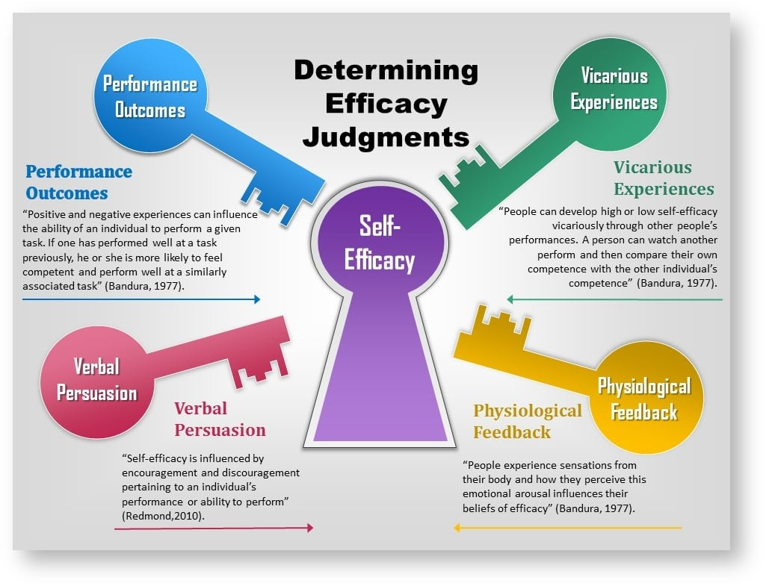
MENTAL SKILLS – SELF-CONFIDENCE
Bandura’s model of self-efficacy
Home

Slide 28
MENTAL SKILLS – SELF-CONFIDENCE
Strategies to improve self confidence and reach the ‘Zone’
Previous successful performance under similar conditions increases the likelihood of another successful performance.
A player reflects on what contributed to the previous successful result and repeats them in the current performance.
Positive body language creates confidence, negative body language does the opposite.
A competitor’s body language can also affect their opponent who observes this behaviour.
Self-confidence increases if an athlete knows that their body has been properly conditioned to meet the demands of competition.
Performance success
Acting confidently
Be physically prepared
Home

Slide 29
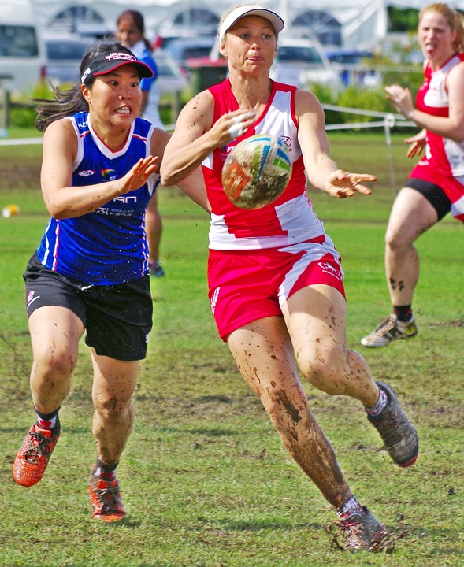
MENTAL SKILLS – SELF-CONFIDENCE
Through training, an athlete feels confident they have practiced the different scenarios which may present during a game
e.g. basketball teams practice set plays or a football team practice maintaining possession if leading with only two or three minutes left in the game.
Positive self and team talk increase self-confidence within the group.
Encouragement and support of team mates who are struggling or making mistakes will improve their performances.
Game trained
Maintain positive self talk
https://pixabay.com/photos/rugby-tag-women-rugby-tag-rugby-1059948/
Home

Slide 30
MENTAL SKILLS – SELF-CONFIDENCE
Self-confidence increases if individuals are confident that the game plan or strategy is appropriate for the upcoming performance and that they have the skills necessary to fulfill their expected role in the contest.
Positive feedback given either during or after the game re-enforces the good things a player has done.
This results in an increase in the self-confidence of the player involved and an increased likelihood of the player repeating the behaviour.
Creating a mental image of a perfect performance using as many senses as possible.
Confident of game plan/tactics
Positive feedback
Imagery
Home

Slide 31
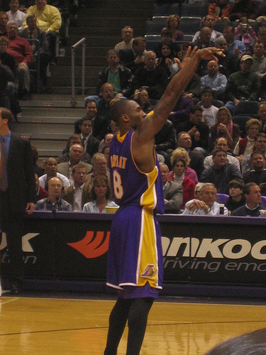
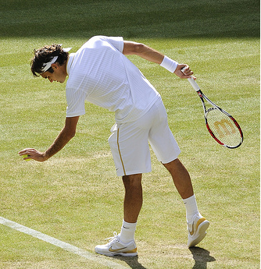
MENTAL SKILLS – SELF-CONFIDENCE
Having a reliable, sequenced and time consistent routine enables the performer to gather themselves before producing the desired performance.
The performance routine will also assist in controlling arousal levels.
Performance routines
www.flickr.com/photos/compujeramey/71084472/
www.flickr.com/photos/reefoto-com/3659533467/in/set-72157620545350324/
Basketball player uses routines before taking a free throw
Roger Federer bounces the ball a set number of times as part of his pre – service routines
Home

Slide 32
MENTAL SKILLS – STRESS MANAGEMENT
Mental skills required for improving performance and achieving the ideal performance state (‘the zone’)
intrinsic motivation
self-confidence
stress management
concentration or attentional control – Nideffer’s model
arousal regulation for optimal performance including the inverted U hypothesis
School Curriculum and Standards Authority. Physical Education Studies ATAR Year 11 Syllabus, 2016.
Home

Slide 33
MENTAL SKILLS – STRESS MANAGEMENT
Stress occurs when there is an imbalance between the task requirements and the ability level of the performer to respond in a situation where failure has consequences.
An athlete needs to have a certain level of stress to produce optimal performance.
Too little stress results in boredom, low motivation and poor performance
Optimum stress levels produce best performance
Too high stress levels negatively affect performance
Stress can either be;
Physical which is the body’s reaction to different triggers
Emotional which occurs when a person finds the demands placed on them become too big or difficult to manage
Home

Slide 34
MENTAL SKILLS – STRESS MANAGEMENT
Stress can be a positive factor when the ability of the athlete meets demands of the task and the athlete looks forward to the challenge of the contest. When stress enhances performance, it is referred to as eustress.
Stress becomes negative if the athlete finds the levels of stress excessive and feels threatened by the demands of the task. When stress negatively affects performance, it is referred to as distress.
Demands | Perception | Arousal | Outcome
Situation | Positive (challenge) | Eustress | Enhanced Performance
 | Negative (threat) | Distress | Impaired Performance
Home

Slide 35
MENTAL SKILLS – STRESS MANAGEMENT
There are many factors which place stress on the athlete – these factors can be divided into two categories – situational sources and personality sources
Situation stress is affected by 2 main factors;
The importance of the game
The more important the event, the greater the stress – Grand Finals present more stress than qualifying games.
Experienced players cope with stress better than inexperienced players.
2. Result uncertainty
Stress levels increase if the teams are evenly matched and the result is likely to be very close. Predictable outcomes have lower stress levels.
1. Situation sources
Home

Slide 36
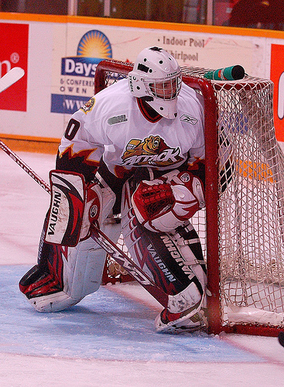
MENTAL SKILLS – STRESS MANAGEMENT
An athletes personality affects how they perceive situations and therefore the amount of stress they experience – challenge vs. threat – “I can’t do this” vs “I’ve been waiting for this opportunity for years! I’m gonna have a crack at it”.
Individual differences impact on how stressful a particular situation is to the athlete.
2. Personal sources
The goal tender can either view the game as a challenge to be met or as a threat.
Viewing the game as a threat increases the stress he feels
www.flickr.com/photos/mylifeswork/3361553270/
Home

Slide 37
MENTAL SKILLS – STRESS MANAGEMENT
Stress and anxiety cause changes to the normal psychological and physiological functioning of the body.
Physiological responses to stress
Psychological responses to stress
Dry mouth
Increased blood pressure
Nausea
Vomiting
Sleeplessness
Muscular tension
Increased respiration rate
Need to urinate
“Butterflies”
Increased adrenalin levels
Indecision
Poor decision making
Missed cues
Imagined cues
Irritability
Fear
Confusion
Loss of confidence
These changes prepare the body to meet the challenge or to avoid it. This is referred to as the “Flight or Fight” response.
Home
©PE STUDIES RESOURCES

Slide 38
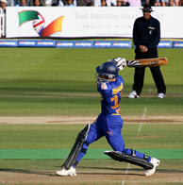
MENTAL SKILLS – STRESS MANAGEMENT
The Zone
Players who have optimal levels of stress and anxiety are capable of producing optimal level performance.
Players in the zone have optimal arousal and produce their best performance as a result of them feeling;
Self confident
Motivated
Alert and ready for unexpected situations
Focused on task at hand.
Mentally in control
Physically in control
Different players are in the zone at different times. This is dependant on what level of state anxiety they require to produce their best performance.
www.flickr.com/photos/zoonabar/3695044225/in/set-72157621055194154/
Home

Slide 39
MENTAL SKILLS – CONCENTRATION
Mental skills required for improving performance and achieving the ideal performance state (‘the zone’)
intrinsic motivation
self-confidence
stress management
concentration or attentional control – Nideffer’s model
arousal regulation for optimal performance including the inverted U hypothesis
influence of age, skill level, and type of activity on mental skills in relation to;
motivation
arousal regulation (inverted U hypothesis)
concentration
School Curriculum and Standards Authority. Physical Education Studies ATAR Year 11 Syllabus, 2016.
Home

Slide 40
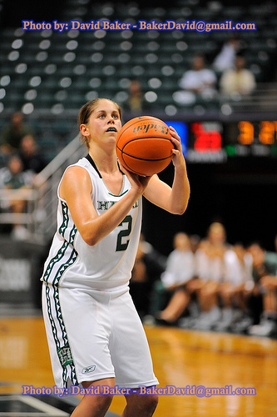
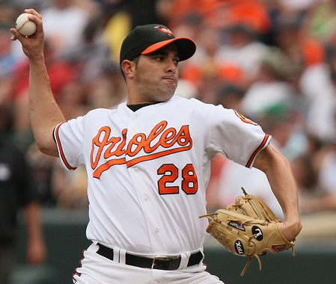
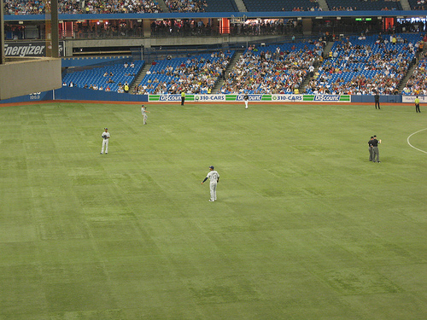
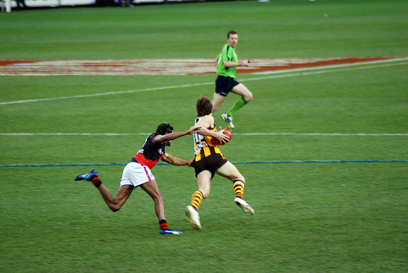
MENTAL SKILLS – CONCENTRATION
Concentration is the ability to focus on task at hand whilst ignoring irrelevant cues or distractions.
Concentration needs to be selective, shiftable, maintainable and situational
1. Selective – focus on certain cues whilst ignoring irrelevant ones
2. Shiftable – broad focus to narrow focus – batter scans outfield for fielders then concentrate on pitcher
3. Maintain – ability to concentrate for the duration of the event
4. Situational – understand the situation around you – size up game situation and take appropriate action
www.flickr.com/photos/davidbaker/2288767138/
www.flickr.com/photos/dougtone/3761904934/in/set-72157621732678769/
www.flickr.com/photos/keithallison/3670489236/in/set-72157620704934200/
www.flickr.com/photos/thomasrdororg/1023664526/
Home

Slide 41
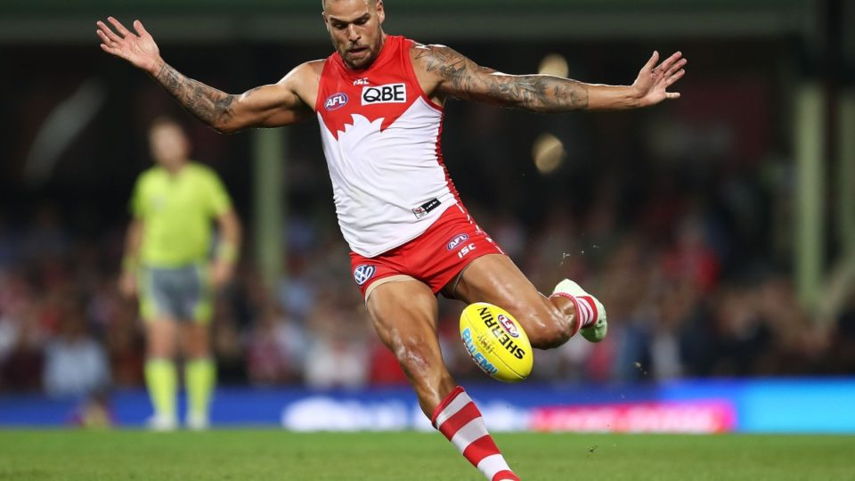
MENTAL SKILLS – CONCENTRATION
Sport related concentration revolves around these 4 aspects – selective attention, shiftable attention, maintaining attention and situational attention.
Focus on important cues and ignore distractions which will affect your performance e.g. footballer kicking at goal must focus only on relevant cues.
1. Selective Attention
All cues in the environment;
Opponents
Crowd
Wind
Distance
Angle
Team mates
Relevant cues;
Wind
Distance
Angle
Which cues are relevant to kicking the goal?
https://thenewdaily.com.au/sport/afl/2018/04/23/buddy-franklin-ball-tampering/
Home

Slide 42
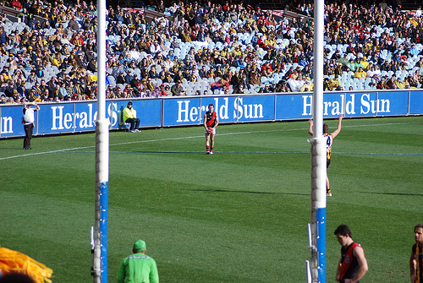
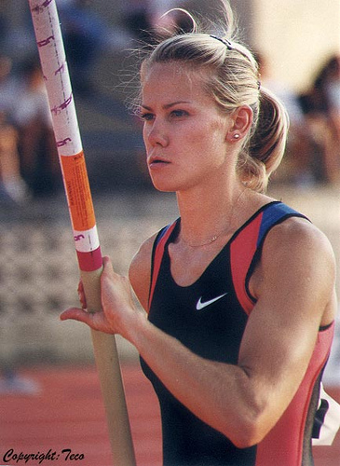
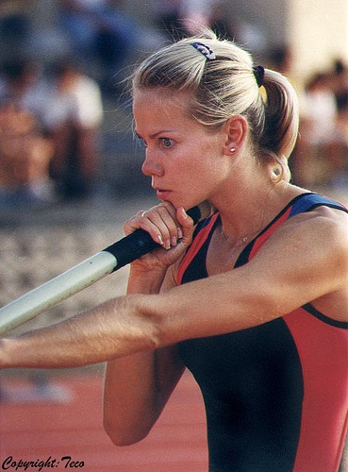
MENTAL SKILLS – CONCENTRATION
www.flickr.com/photos/thomasrdororg/1022625507/
www.flickr.com/photos/tefocoto/1577731435/in/photostream/
www.flickr.com/photos/tefocoto/1578623564/
The footballer needs to concentrate on;
The angle he is on.
The distance he needs to kick the ball
The affect the wind may have on the kick.
He ignores opponents, the crowd and team mates as they are irrelevant to performance once he has made the decision to kick at goal.
Discuss the selective attention requirements of the pole vault.
Cues to focus on?
Distracters?
Home

Slide 43
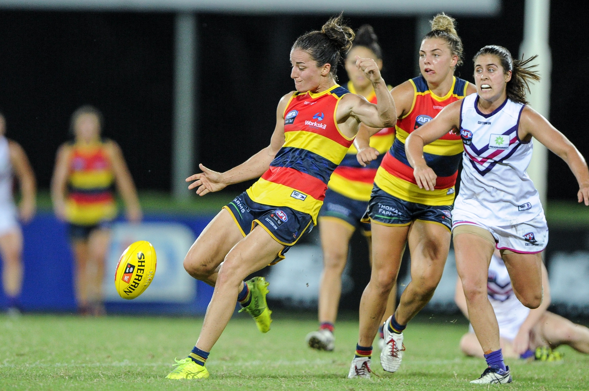
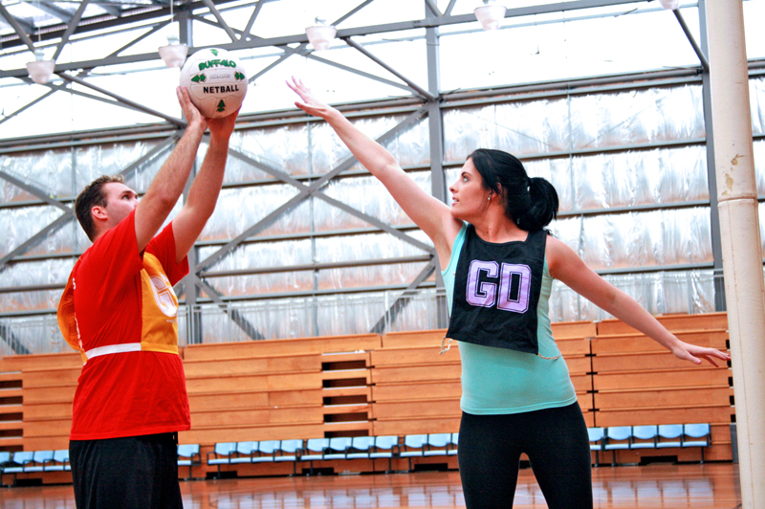
MENTAL SKILLS – CONCENTRATION
Athletes are constantly required to shift their concentration from broad to narrow throughout a game or activity
Think of a full forward in Women's AFL who prior to receiving the ball must attend to a magnitude of cues including where the defenders are positioned, space available, team mates etc. Once they receive the ball, their focus is much more narrow as they prepare to kick on goal.
2. Shiftable Attention
https://commons.wikimedia.org/wiki/File:Angela_Foley_kicking.5.jpg
https://commons.wikimedia.org/wiki/File:Netball_Game_in_Action_-_Guarding.JPG
Home

Slide 44
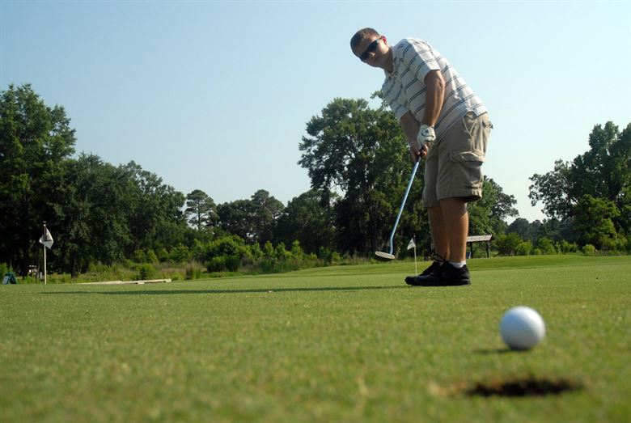
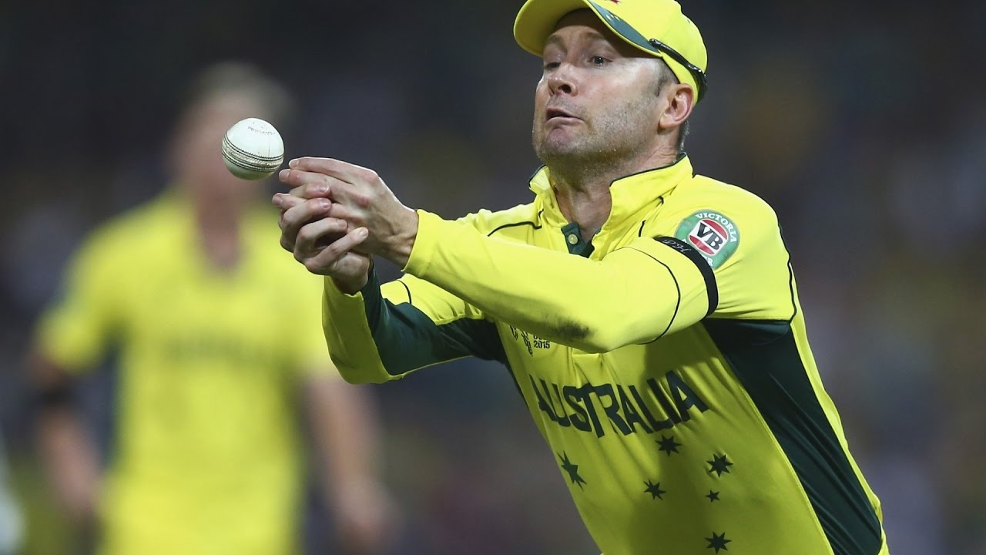
MENTAL SKILLS – CONCENTRATION
Being able to concentrate for the duration of the event – one error can cost the match – dropped catch, missed putt.
It is important athletes train specifically to replicate the attentional demands of the sport. i.e. does the sport have many breaks (cricket) or is it continuous (soccer)? How long are players required to concentrate for?
Elite batters in cricket will often practice for up to 6 hrs per day to try and replicate the attentional demands of an actual game
3. Maintaining Attention
https://www.jbcharleston.jb.mil/News/Article/236672/wrenwoods-offers-summer-golf-deals-to-team-charleston/
https://www.google.com/search?safe=active&client=firefox-b-d&biw=1920&bih=983&tbs=sur%3Afc&tbm=isch&sa=1&ei=ZDP1XIKsL5HfrQHl-6X4DA&q=dropped+catch&oq=dropped+catch&gs_l=img.3..0l2j0i5i30l6j0i24l2.233070.235170..236564...0.0..0.230.2685.0j6j7......0....1..gws-wiz-img.......0i67j0i8i30.ENeHcU-0vpw#imgrc=VfonfoSVUZSmhM:
Home

Slide 45
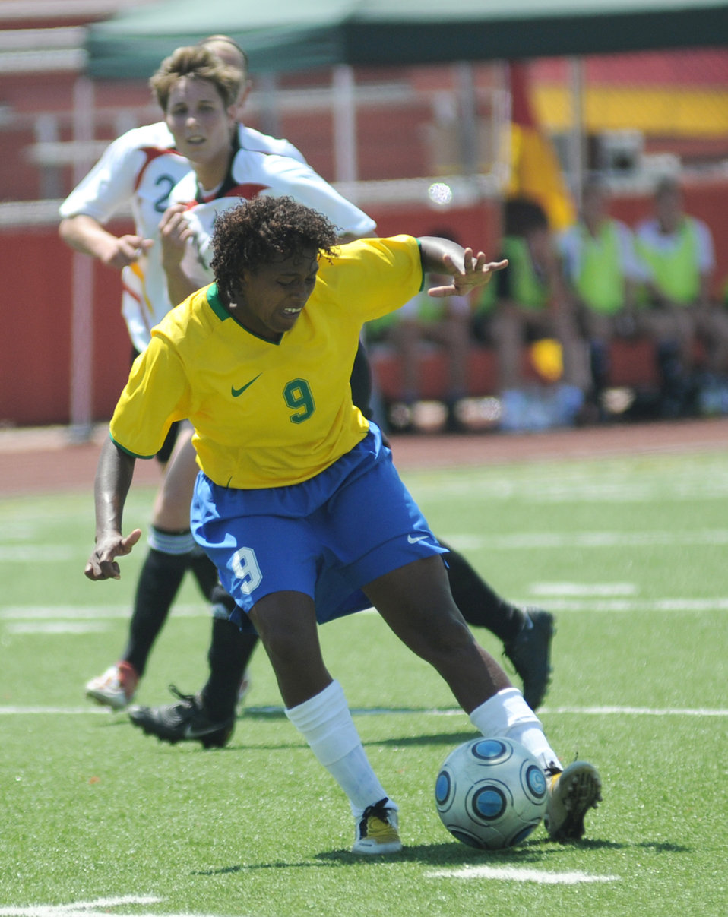
MENTAL SKILLS – CONCENTRATION
The ability of the performer to consider the game situation, positioning of team mates and opposition and then make appropriate decision on course of action e.g.
when do you start to run down the clock?
when do you make substitutions?
when do you take extra risks?
who do you pass to?
who don’t you pass to?
4. Situation Awareness
http://www.publicdomainfiles.com/show_file.php?id=13496550016664
Home

Slide 46
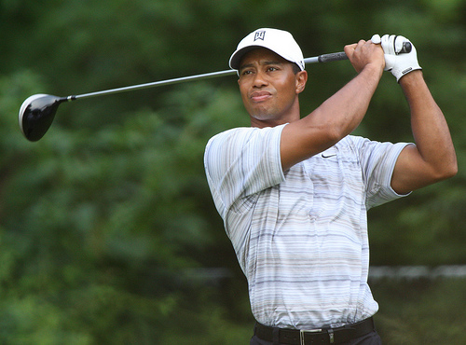
MENTAL SKILLS – CONCENTRATION
Nideffer’s Model of Attention
Robert Nideffer (1981) determined that different sports have different attentional requirements and viewed attentional focus along two dimensions;
Direction: Focus on whether cues are internal or external to the performer
Width: Focus on whether cues are broad – many cues available at once – or narrow where there are limited relevant cues to attend to.
Attentional Requirements of Golf;
Narrow External: There are only a few cues in the environment which are all stable.
Narrow Internal: Tiger might use imagery and mental rehearsal before performing his shot.
Four Attentional Styles - Sport Psych NSCA CSCS Exam - YouTube
www.flickr.com/photos/keithallison/2311055636/
Home

Slide 47
MENTAL SKILLS – CONCENTRATION
External
Broad – External
Attention paid to a large number of cues in the external environment.
Required for open skilled team sports.
Narrow – External
Focused targeting which is the ability to block out distractions and focus on specific cues.
Required for target sports
DIRECTION
Broad
Narrow
Broad – Internal
Attention paid to internal thoughts and images.
Analysis, problem solving, visualising, determining strategies.
Narrow – Internal
Focus on a specific image, thought or coaching point with few other cues.
A golfer might focus on getting his putt past the hole.
Internal
Home
WIDTH

Slide 48
MENTAL SKILLS – CONCENTRATION
External
Broad – External
Used to rapidly assess a situation e.g. player running with the ball looks downfield for options
Narrow – External
Used to focus on one or two external cues e.g. the ball or target
DIRECTION
Narrow
Broad
Broad – Internal
Used to analyse and plan e.g. develop specific game plan or strategy
Narrow – Internal
Used to mentally rehearse an upcoming performance e.g. mentally rehearsing a gymnastics routine.
Internal
Home
WIDTH

Slide 49
MENTAL SKILLS – CONCENTRATION
External
Broad – External
Basketball
Volleyball
Narrow – External
Golf
Lawn bowls
DIRECTION
Narrow
Broad
Broad – Internal
Tennis
Badminton
Narrow – Internal
Marathon
Weight lifting
Internal
Home
WIDTH

